Slide 1
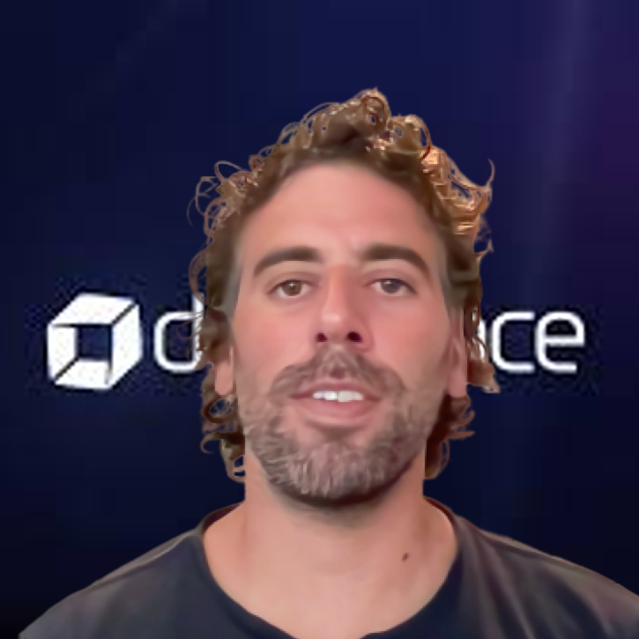
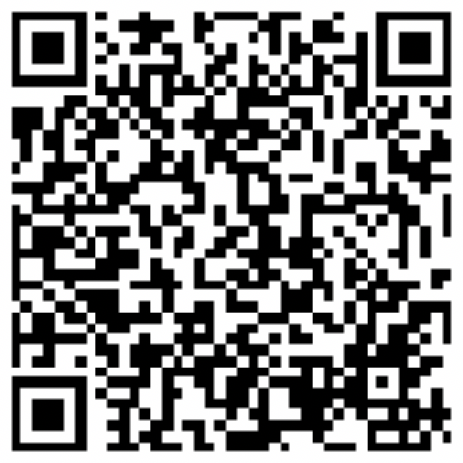
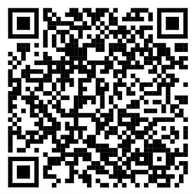

Platform Engineering in Action
Pere Sureda
Principal Platform Engineer
Dynatrace – Mallorca
github.com/peresureda
Vamos a simplificar la vida de nuestros equipos de desarrollo con una reducción drástica del tiempo de OnBoarding de una nueva aplicación.
LinkedIn

Slide 2





¿ Como empezamos ?
Pain Points
KPIs
User/Dev Experience
Monitorización
Notes:
Examples for each out:
Pain Points: Its hard to onboard a new application with automated delivery, security checks and observability built in
Clear Mission: Platform needs to reduce developer productivity measured through e.g: newly onboarded services or pipeline runs
Good User Experience: Ask your users how they work right now and find the best model to make the platform „fit in“
Start Small: Find one use case that solves a pain of more than 1 team -> then implement this one!
Observability: Observe your platform (needs to run smooth), observe your users (how is it adopted), bring observability to the apps that they are deploying (should be a core capability anyway)

Slide 3

How to Build a Successful Platform?
Find the pain points and needs of your users
Have a clear mission with measurable KPIs
Design for a good User/Dev Experience
Start with the TVP (Thinnest Viable Platform)
Make everything observable
Notes:
Examples for each out:
Pain Points: Its hard to onboard a new application with automated delivery, security checks and observability built in
Clear Mission: Platform needs to reduce developer productivity measured through e.g: newly onboarded services or pipeline runs
Good User Experience: Ask your users how they work right now and find the best model to make the platform „fit in“
Start Small: Find one use case that solves a pain of more than 1 team -> then implement this one!
Observability: Observe your platform (needs to run smooth), observe your users (how is it adopted), bring observability to the apps that they are deploying (should be a core capability anyway)

Slide 4
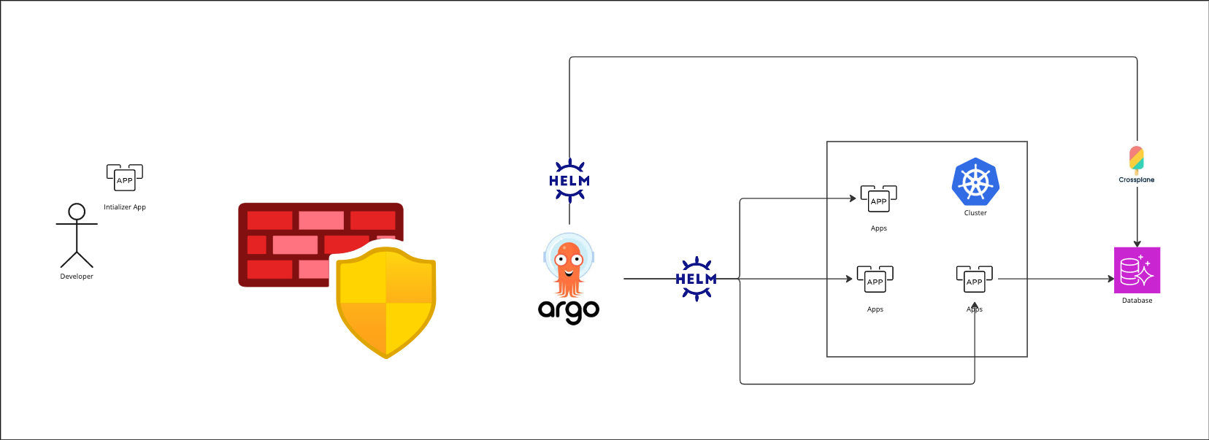
Nuestro Use Case
Notes:
Examples for each out:
Pain Points: Its hard to onboard a new application with automated delivery, security checks and observability built in
Clear Mission: Platform needs to reduce developer productivity measured through e.g: newly onboarded services or pipeline runs
Good User Experience: Ask your users how they work right now and find the best model to make the platform „fit in“
Start Small: Find one use case that solves a pain of more than 1 team -> then implement this one!
Observability: Observe your platform (needs to run smooth), observe your users (how is it adopted), bring observability to the apps that they are deploying (should be a core capability anyway)

Slide 5
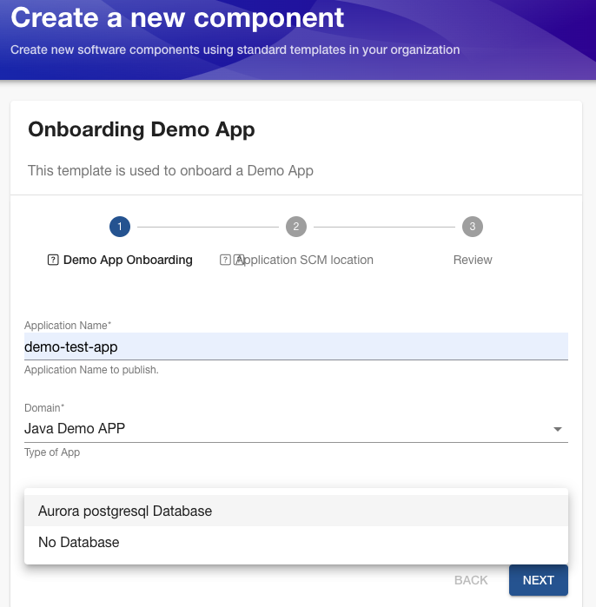
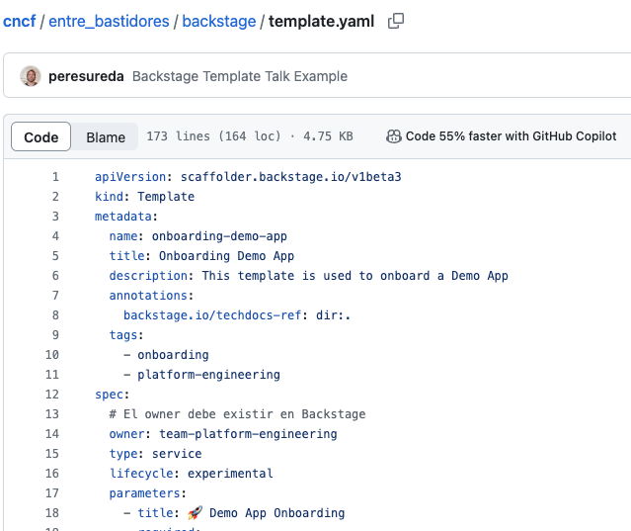
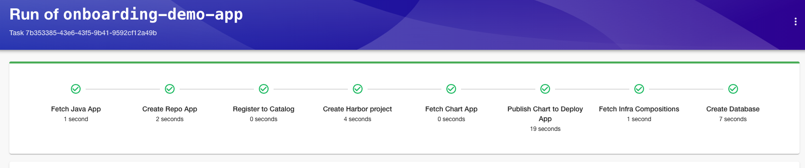
Backstage
Backstage Software Catalog
Backstage Software Templates
TechDocs Documentation
Notes:
Examples for each out:
Pain Points: Its hard to onboard a new application with automated delivery, security checks and observability built in
Clear Mission: Platform needs to reduce developer productivity measured through e.g: newly onboarded services or pipeline runs
Good User Experience: Ask your users how they work right now and find the best model to make the platform „fit in“
Start Small: Find one use case that solves a pain of more than 1 team -> then implement this one!
Observability: Observe your platform (needs to run smooth), observe your users (how is it adopted), bring observability to the apps that they are deploying (should be a core capability anyway)

Slide 6
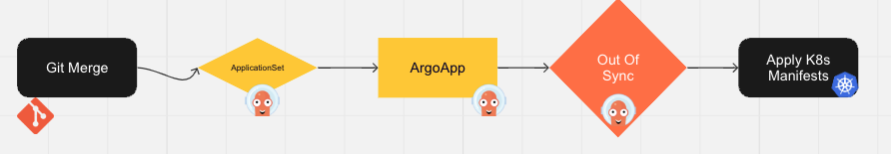
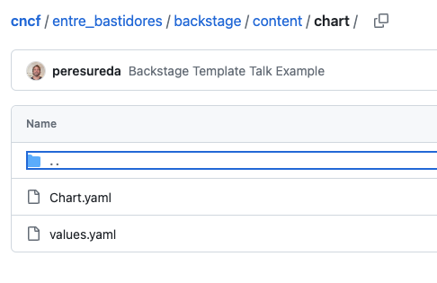
App Deployment
Helm Chart Template
Jenkinsfile
Renovate/Semantic Release
Notes:
Examples for each out:
Pain Points: Its hard to onboard a new application with automated delivery, security checks and observability built in
Clear Mission: Platform needs to reduce developer productivity measured through e.g: newly onboarded services or pipeline runs
Good User Experience: Ask your users how they work right now and find the best model to make the platform „fit in“
Start Small: Find one use case that solves a pain of more than 1 team -> then implement this one!
Observability: Observe your platform (needs to run smooth), observe your users (how is it adopted), bring observability to the apps that they are deploying (should be a core capability anyway)

Slide 7
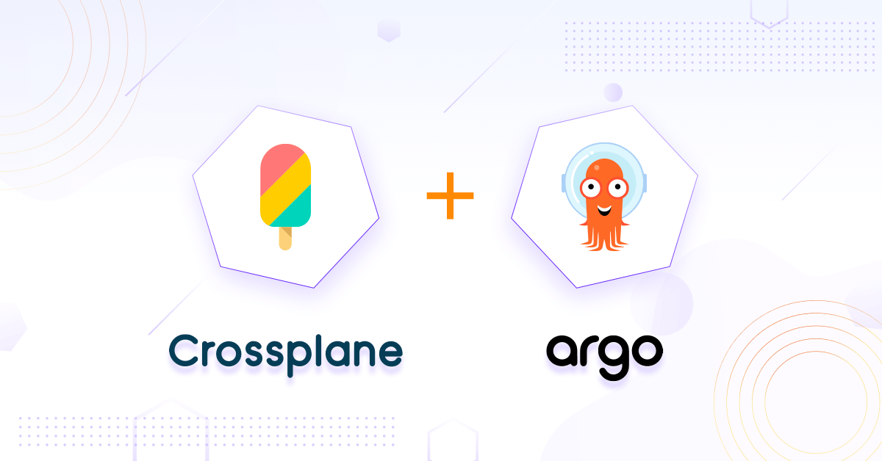
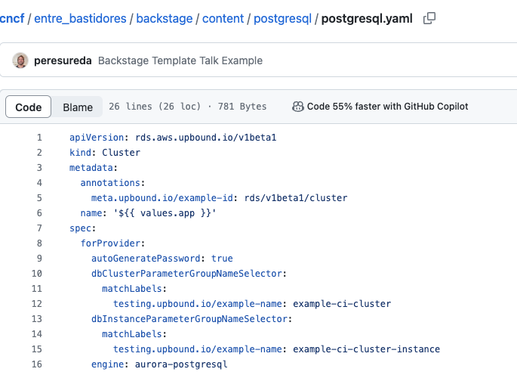
Crossplane
Crossplane Providers
Compositions
Managed Resources
Notes:
Examples for each out:
Pain Points: Its hard to onboard a new application with automated delivery, security checks and observability built in
Clear Mission: Platform needs to reduce developer productivity measured through e.g: newly onboarded services or pipeline runs
Good User Experience: Ask your users how they work right now and find the best model to make the platform „fit in“
Start Small: Find one use case that solves a pain of more than 1 team -> then implement this one!
Observability: Observe your platform (needs to run smooth), observe your users (how is it adopted), bring observability to the apps that they are deploying (should be a core capability anyway)

Slide 8
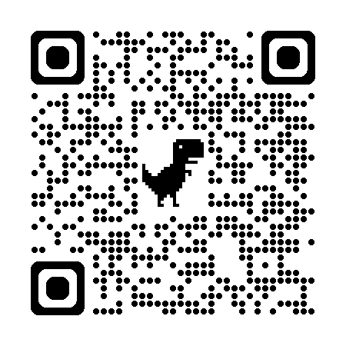
Gràcies!!!
Pere Sureda
Principal Platform Engineer
Dynatrace - Mallorca

